Slide 1
WELCOME
Things to know before we get started:
There's an Information Pack (& other Amnesty resources) available for each of you to take away
It contains a range of leaflets, pamphlets, guides etc. as well as a list of useful web links (to this presentation and to other sites where you can follow up on particular human rights activities according to your interests and concerns.)
We will provide occasional opportunities for you to ask questions as we go along, but there will be 10 minutes at the end for a dedicated Q & A session.

Slide 2
AMNESTY INTERNATIONAL getting involved!
YOUSUF ZubaiR & Keith Webb

Slide 3
What is Amnesty?
A global movement of over seven million people; the world's largest grassroots human rights organisation
Working to protect people wherever justice, freedom, truth and dignity are denied
Investigating and exposing abuses, educating and mobilising the public, and transforming societies to create a safer, more just world

Slide 4
What are human rights?

Slide 6
What does Amnesty do?

Slide 7
Our Activities:
Refugee week, Write for Rights, Silenced Voices Exhibition
Competitions
Petitions, letters, influencing government & policy
Media

Slide 8
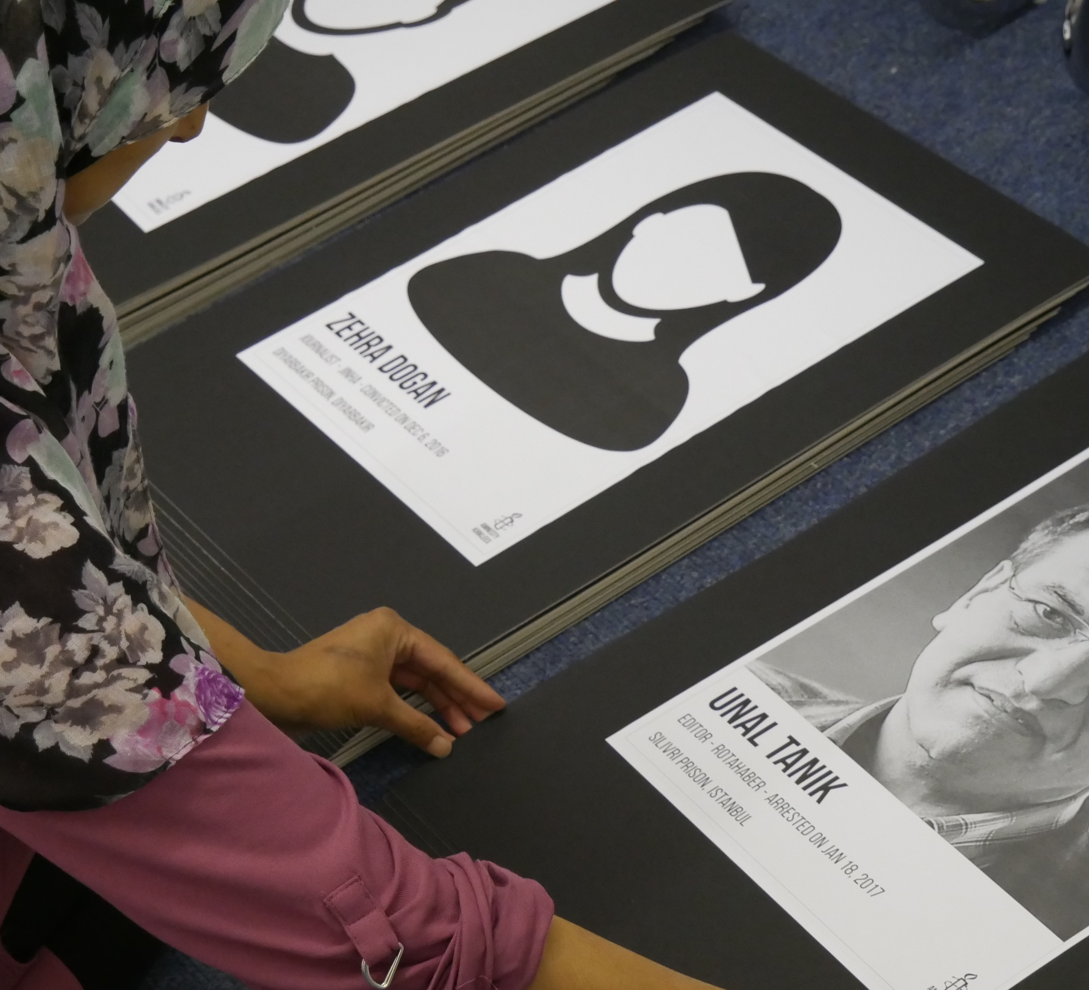
What can you do?
CAMPAIGNING
Fundraising
Organisation
Communications

Slide 9
What can you do?
MEETINGS
Task Leaders
Social Media Account Manager
Web site design & management
Social events organiser
Recruitment of new members
Fund-raising team co-ordinator
Press/media Officer
Team Members
Fundraiser
Activist

Slide 10
What can you do?
EDUCATION &
TRAINING
Preparation
Staffing
Presentations
Workshops

Slide 11
Moving forward…
o Set up your college’s own Amnesty group/society
o Choose Amnesty as a charity for college-wide fundraising
o Join Amnesty International as an individual member/follow our work nationally
o Invite Amnesty Kirklees back for a follow-up event…

Slide 12
Please take an Information Pack as you leave!
It contains a range of leaflets, pamphlets, guides etc. as well as this list of ways to follow up any Amnesty-related interests:
Kirklees Amnesty Group: facebook.com/AmnestyKirklees or amnestykirklees.org.uk *
Amnesty International UK: amnesty.org.uk
For particular interests or concerns use “Search” or, for example, add “campaigns”, “issues”, “get-involved”, “fund-raising”, “student-action-network” “actions” etc.)
Amnesty International amnesty.org/en/
UN Convention on the Rights of the Child: www.unicef.org/child-rights-convention
Liberty: https://www.libertyhumanrights.org.uk
Reprieve: https://reprieve.org.uk
* The slides from this presentation and a volunteer sign-up sheet are available here

